Slide 1
Augmenting End-to-End Dialogue Systems with Commonsense Knowledge YOUNG, T.; CAMBRIA, E.; CHATURVEDI, I.; ZHOU, H.; BISWAS, S.; HUANG, M.. Augmenting End-to-End Dialogue Systems With Commonsense Knowledge. AAAI Conference on Artificial Intelligence, North America, apr. 2018.
孟庆钢
2019.04.22
Notes:
Dialogue
单轮
基于检索

Slide 2
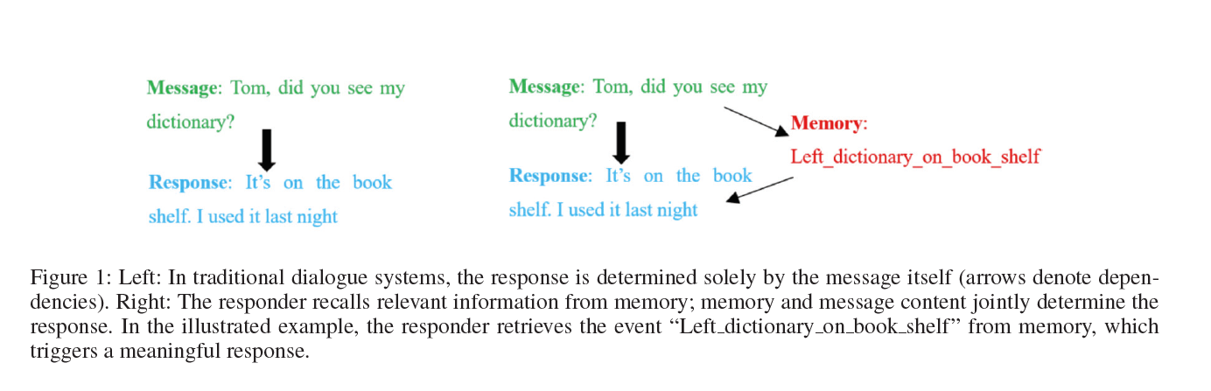
Abstract & Introduction

Slide 3
Related Work: Commonsense Knowledge
Commonsense Knowledge Base: ConceptNet and SenticNet
Commonsense Knowledge Base can be seen as a semantic network where concepts are nodes in the graph and relations are edges.
ConceptNet contains:
Objective facts: Paris is the capital of France
Everyday knowledge: A dog is a pet
Each <concept1, relation, concept2> triple is termed an assertion.
Notes:
Objective facts：客观事实
The aim of commonsense knowledge representation and reasoning
is to give a foundation of real-world knowledge to a variety of AI applications

Slide 4
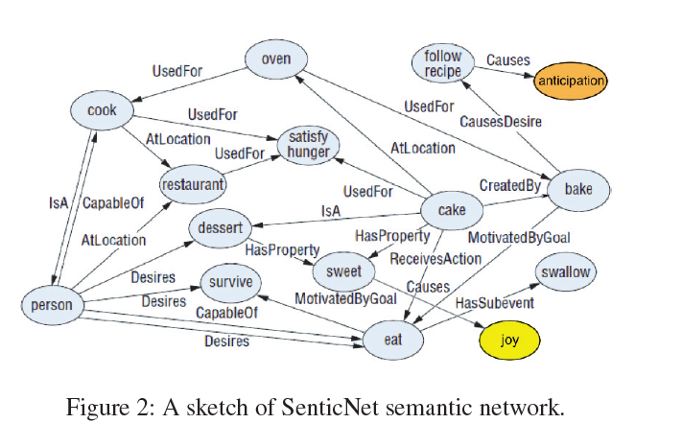
Related Work: Commonsense Knowledge

Slide 5
Model Description: Task Definition
We concentrate on integrating commonsense knowledge into retrieval-based conversational models, because they are easier to evaluate (Liu et al. 2016; Lowe et al. 2016a) and generally take a lot less data to train.

Slide 6

Model Description: Task Definition
x: message or context
y: response
V: tokens (words)
Given x and a set of response candidates [y1, y2, y3..., yK] ∈ Y.
Chooses y according to:
f(x, y) is a scoring function measuring the “compatibility” of x and y.
The model is trained on <message, response, label> triples with cross entropy loss, where label is binary indicating whether the <message, response> pair comes from real data or is randomly combined.
Notes:
Message (context) x and response y are a sequence of tokens from vocabulary V .
Cross Entropy Loss (交叉嫡验证): 两个概率分布的距离，越小越好

Slide 7
Model Description: Commonsense Knowledge Retrieval
We assume that a commonsense knowledge base is composed of assertions A about concepts C.
Each assertion a ∈ A takes the form of a triple <c1, r, c2>, where r ∈ R is a relation between c1 and c2, such as IsA, CapableOf, etc. c1, c2 are concepts in C.
The relation set R is typically much smaller than C.
c can either be a single word or a multi-word expression.
We build a dictionary H out of A where every concept c is a key and a list of all assertions in A concerning c, i.e., c = c1 or c = c2, is the value.
Our goal is to retrieve commonsense knowledge about every concept covered in the message.

Slide 8
Model Description: Commonsense Knowledge Retrieval
We define A_{x} as the set of commonsense assertions concerned with message x.
To recover concepts in message x, we use simple n-gram matching (n ≤ N). Every n-gram in c is considered a potential concept. If the n-gram is a key in H, the corresponding value, i.e., all assertions in A concerning the concept, is added to A_{x} (Figure 4).
Notes:
n-gram matching？：分词
N: 5

Slide 9
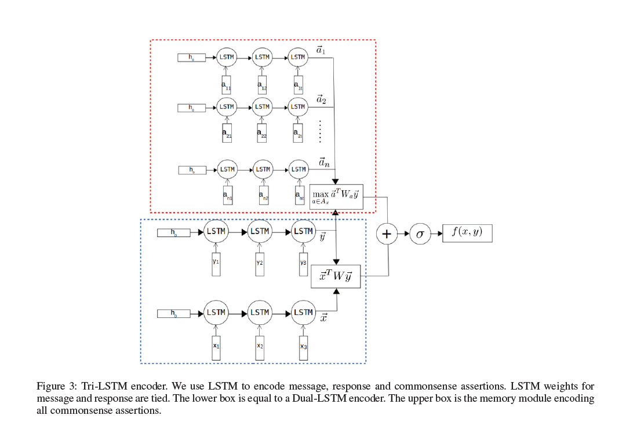
Model

Slide 10
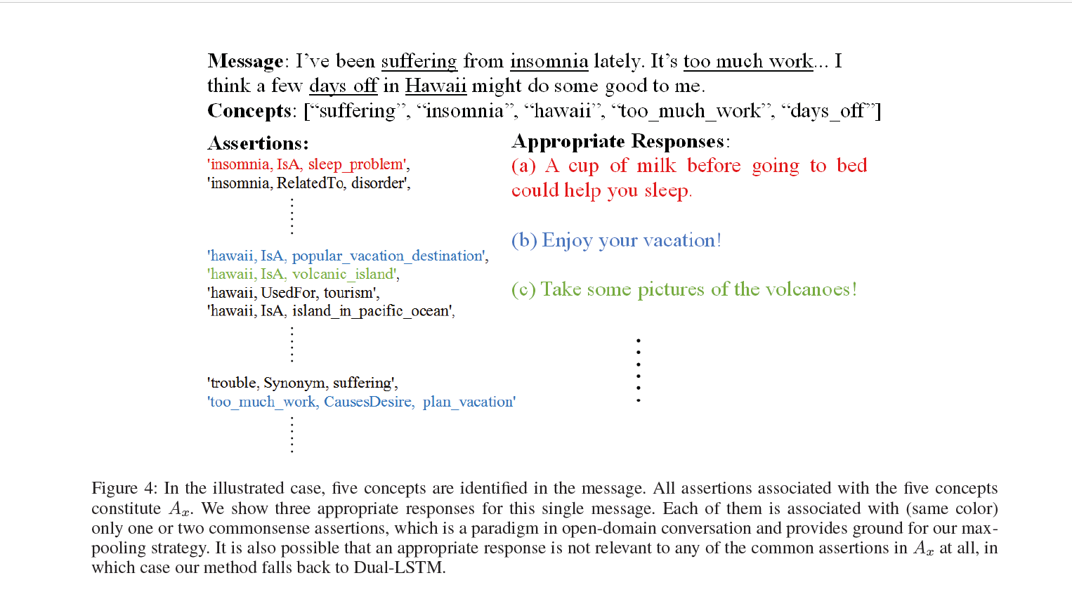

Slide 11
Experiments: Twitter Dialogue Dataset
1.4M Twitter <message, response> pairs are used for our experiments.
1M Twitter<message, response> pairs are used for training.
1M <message, response, label=1> triples as positive instances.
1M negative instances <message, response, label=0> are constructed by replacing the ground truth response with a random response in the training set.
For tuning and evaluation, we use 20K <message, response> pairs that constitute the validation set (10K) and test set (10K).
Notes:
tuning: 调整
evaluation: 评估

Slide 12
Experiments: ConceptNet
1.4M concepts remain. 0.8M concepts are unigrams, 0.43M are bi-grams and the other 0.17M are tri-grams or more.
Each concept is associated with an average of 4.3 assertions.
More than half of the concepts are associated with only one assertion.
An average of 2.8 concepts can be found in ConceptNet for each message in our Twitter Dialogue Dataset, yielding an average of 150 commonsense assertions (the size of Ax).
Notes:
unigrams
bi-grams
tri-grams

Slide 13
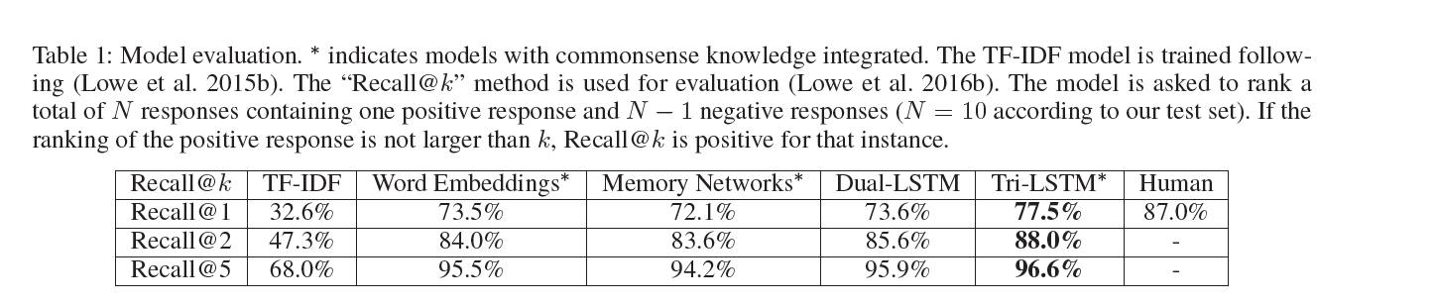
Results and Analysis
LSTMs perform better than other methods.
Tri-LSTM > Dual-LSTM
Max-pooling over all commonsense assertions depending on response y is a better method for utilizing commonsense knowledge than attention over memory in our setting, as demonstrated by the gain of performance of word embeddings over memory networks.

Slide 14
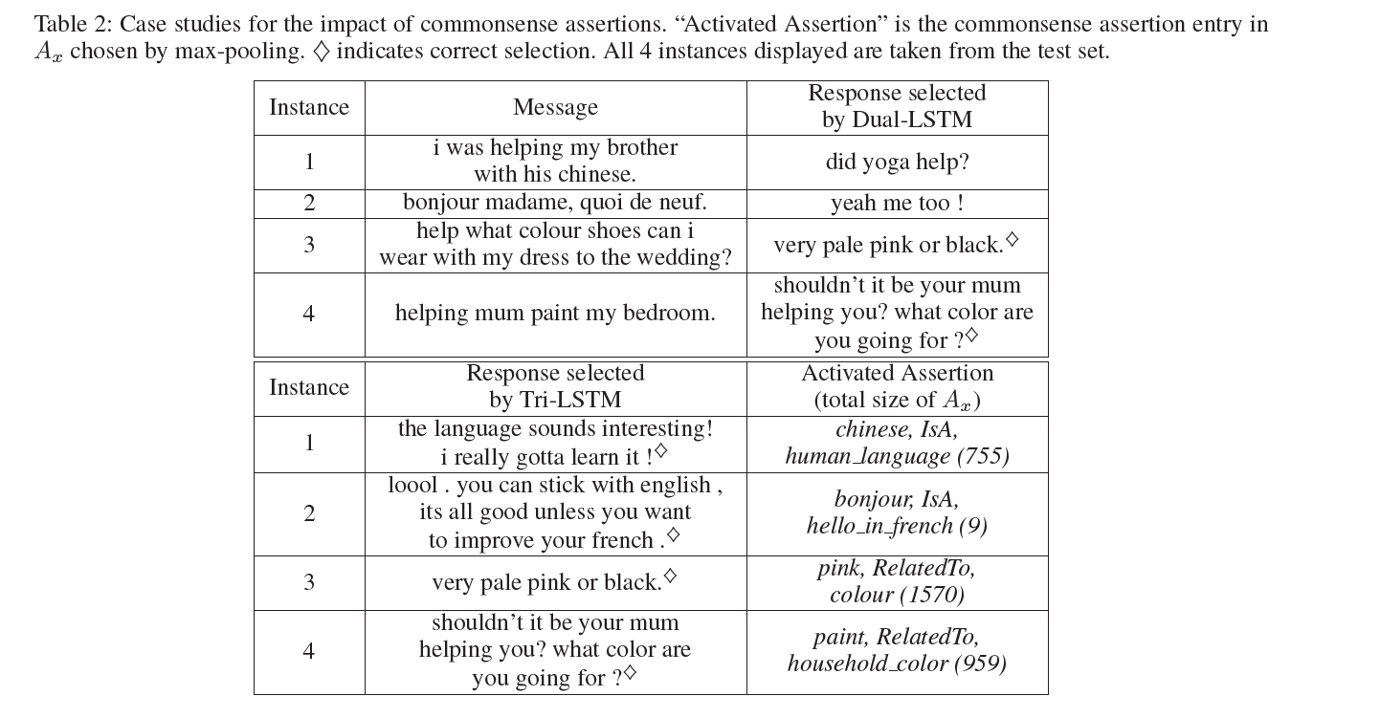
Notes:
instance 3: Informally speaking, such cases suggest that to some extent, Dual-LSTM (models with no memory) is able to encode certain commonsense knowledge in model parameters (e.g., word embeddings) in an implicit way.
instance 4: In other cases, e.g., instance 4, the message itself is enough for the selection of the correct response, where both models do equally well.

Slide 16
Abstract & Introduction
By relying on a large number of message-response pairs, the Seq2Seq framework (Sutskever, Vinyals, and Le 2014) attempts to produce an appropriate response based solely on the message itself, without any memory module.
In this paper, we investigate the impact of providing commonsense knowledge about the concepts covered in the dialogue.
Such information may contain personal experience, recent events, commonsense knowledge and more (Figure 1).

Slide 17
Abstract & Introduction
In the context of artificial intelligence (AI), commonsense knowledge is the set of background information that an individual is intended to know or assume and the ability to use it when appropriate (Minsky 1986; Cambria et al. 2009; Cambria and Hussain 2015).
Due to the vastness of such kind of knowledge, we speculate that this goal is better suited by employing an external memory module containing commonsense knowledge rather than forcing the system to encode it in model parameters as in traditional methods.

Slide 18
Related Work: Conversational Models
Data-driven conversational models
retrieval-based methods
generation-based methods
Notes:
generation-based methods: which employ an encoder-decoder framework where the message is encoded into a vector representation and, then, fed to the decoder to generate the response.
dull or vague: 枯燥的，含糊的
The latter is more natural (as it does not require a response repository) yet suffers from generating dull or vague responses and generally needs a great amount of training data.
The model we propose in this work shares similarities with (Lowe et al. 2015a), which encoded unstructured textual knowledge with a recurrent neural network (RNN).

Slide 19

Model Description: Dual-LSTM Encoder
The Dual-LSTM encoder (Lowe et al. 2015b) represents the message x and response y as fixed-size embeddings x and y with the last hidden states of the same LSTM.
The compatibility function of the two is thus defined by:
where matrix W ∈ R^{D×D} is learned during training.

Slide 20

Model Description: Tri-LSTM Encoder
Our main approach to integrating commonsense knowledge into the conversational model involves using another LSTM for encoding all assertions a in Ax.
Each a(assertions) <c1, r, c2> is transformed into [c11, c12, c13..., r, c21, c22, c23...].
We add R to vocabulary V , that is, each r in R will be treated like any regular word in V during encoding.
We decide not to use each concept c as a unit for encoding a because C is typically too large (>1M).
a is encoded as embedding representation a using another LSTM.

Slide 21

Model Description: Tri-LSTM Encoder
We define the match score of assertion a and response y as:
where W_{a} ∈ R^{D×D} is learned during training.
Commonsense assertions A_{x} associated with a message is usually large (>100 in our experiment).

Slide 22

Model Description: Tri-LSTM Encoder
Our assumption is that A_{x} is helpful in selecting an appropriate response y.
However, usually very few assertions in A_{x} are related to a particular response y.
We define the match score of A_{x} and y as:
We only consider the commonsense assertion a with the highest match score with y, as most of A_{x} are not relevant to y.

Slide 23

Model Description: Tri-LSTM Encoder
Incorporating m(Ax, y) into the Dual-LSTM encoder, our Tri-LSTM encoder model is thus defined as:
In cases where Ax = ∅, i.e., no commonsense knowledge is recalled, m(Ax, y) = 0 and the model degenerates to Dual-LSTM encoder.

Slide 24
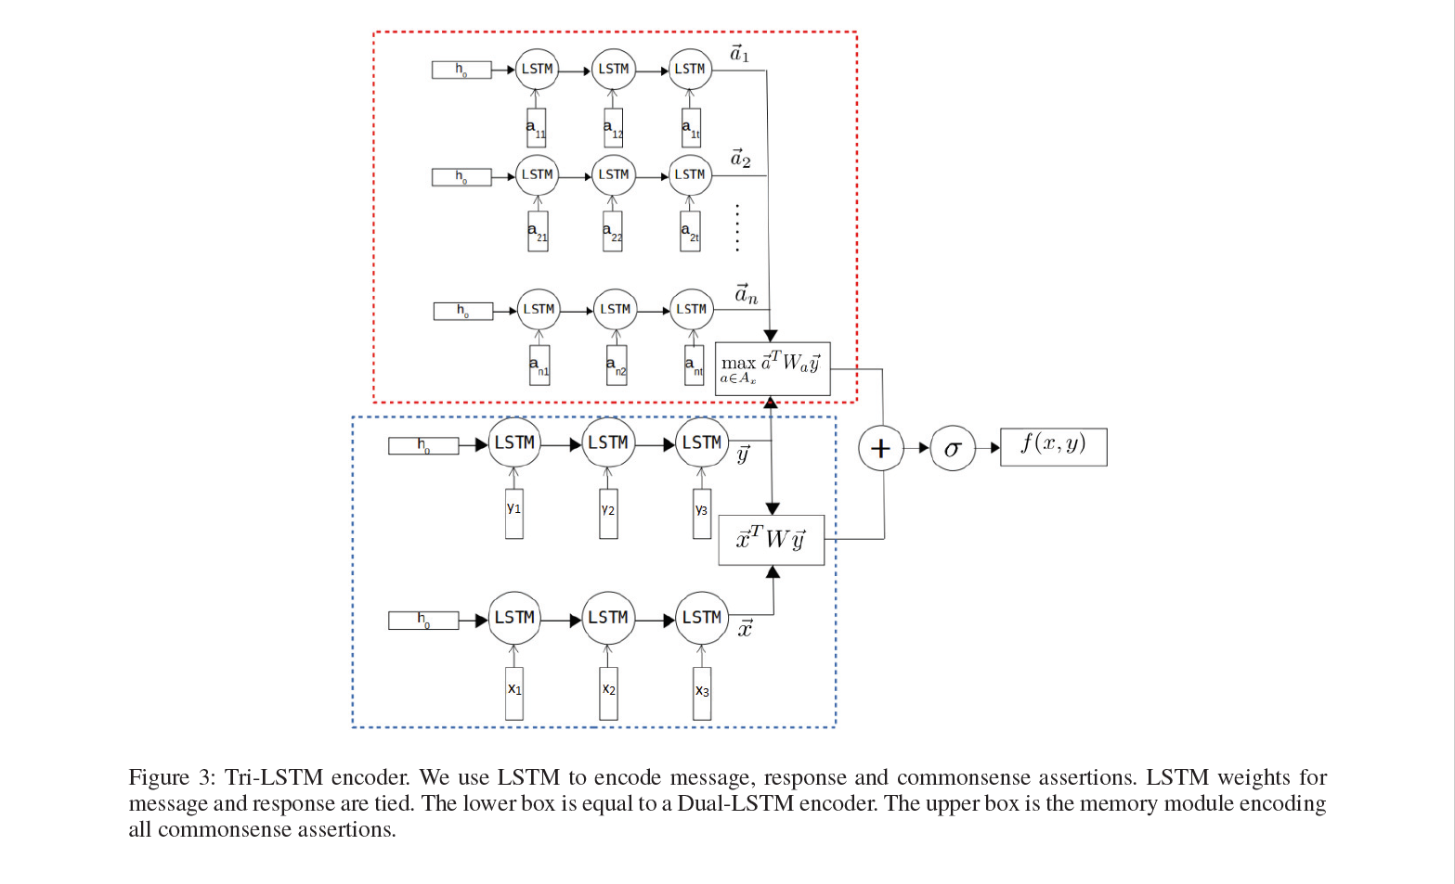

Slide 25
Model Description: Comparison Approaches
Supervised Word Embeddings
Memory Networks
Notes:
Word Embeddings
attention

Slide 26
Experiments: ConceptNet
It is worth noting that ConceptNet is also noisy due to uncertainties in the constructing process, where 15.5% of all assertions are considered “false” or “vague” by human evaluators (Speer and Havasi 2012).
Our max-pooling strategy used in Tri-LSTM encoder and supervised word embeddings is partly designed to alleviate this weakness.
Notes:
max-pooling and average-pooling
vague：不清楚的，含糊的

Slide 27
Experiments: Parameter Settings
In all our models excluding term frequency–inverse document frequency (TF-IDF) (Ramos and others 2003), we initialize word embeddings with pretrained GloVe embedding vectors (Pennington, Socher, and Manning 2014). The size of hidden units in LSTM models is set to 256 and the word embedding dimension is 100. We use stochastic gradient descent (SGD) for optimizing with batch size of 64. We fixed training rate at 0.001.

Slide 28
Conclusion and Future Work

